Slide 1
ONLINE SHOPPING MANAGEMENT SYSTEM
NAME-TANYA
ROLL NUMBER- 2K22/CO/472
BRANCH- COMPUTER SCIENCE AND ENGINEERING

Slide 2
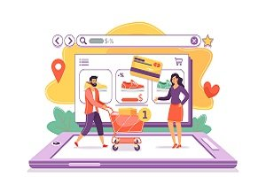
OVERVIEW
1- INTRODUCTION
2- REQUIREMENTS
3- FEASIBILITY
4- BENEFITS
5-POPULAR PLATFORMS
6- CHALLENGES AND ITS SOLUTIONS
7-CONCLUSION

Slide 3

INTRODUCTION-
Online shopping is a form of electronic commerce which allows consumers to directly buy goods or services from a seller over the Internet using a web browser or a mobile app.
Types of online shopping are-
Casual wear
Marketplaces
Medicines
Grocery shopping

Slide 4
REQUIREMENTS-
SOFTWARE- WINDOWS OS: xp / 7 / 8 / 8.1
Or MAC OS
Or LINUX
Browser
HARDWARE – RAM : 128 or higher
Processor-Pentium or higher

Slide 5
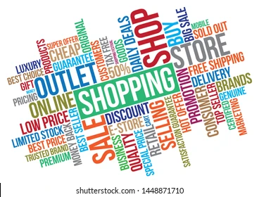

Slide 6

FEASIBILITY-
TECHNICAL FEASIBLE- It was feasible because of current and latest technologies .
FINANCIAL FEASIBLE- Online shopping is feasible to customers as it is free and easy to use
OPERATIONAL FEASIBLE- Easy to use.

Slide 7
BENEFITS OF ONLINE SHOPPING
Convenience
You can save time by avoiding trips to the store and the time it takes to pick out items, purchase, and pay. You can also avoid crowds and pressure to make impulsive decisions.
Variety
You can find a wider selection of brands and products online, including items that might not be available in stores. You can also shop worldwide and have items delivered to your home.
Cost
Online stores can offer lower prices because they don't have the same overhead costs as physical stores. You can also compare prices across multiple stores without having to travel between them.
Gift sending
It's easier to send gifts to friends and family, no matter where they are.
Payment options
Online payments can be faster, easier, and more convenient than traditional payment methods. You can also save money by avoiding parking fees and impulse purchases.

Slide 8
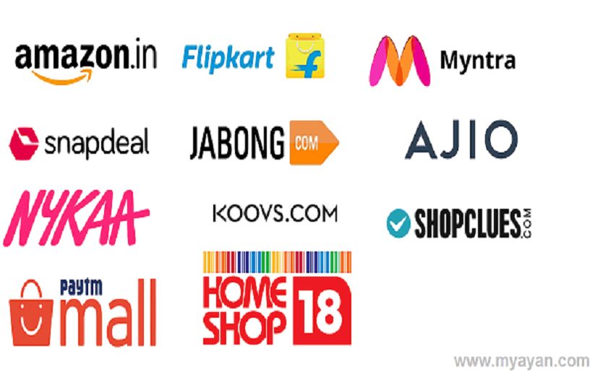
POPULAR PLATFORMS -
Amazon India
Flipkart
Myntra
Ajio
Tata CLiQ
Shoppers Stop
Max Fashion
Blinkit

Slide 9
Challenges and its solutions
1. Security Concerns
Challenge: Online shopping involves sharing personal and financial information, which can be vulnerable to cyber attacks and fraud.
Solution: Implement advanced security measures like SSL encryption, two-factor authentication, and regular security audits to protect customer data.
2. Delivery Issues
Challenge: Problems such as delayed deliveries, lost packages, and damaged goods can negatively impact customer satisfaction.
Solution: Partner with reliable logistics providers, offer tracking information, and provide prompt customer service to resolve delivery issues.
3. Product Quality and Authenticity
Challenge: Customers cannot physically inspect products before purchasing, leading to concerns about quality and authenticity.
Solution: Provide detailed product descriptions, high-quality images, customer reviews, and a robust return policy to build trust and ensure customer satisfaction.

Slide 10
CONCLUSION-
Online shopping has revolutionized the retail industry, offering unparalleled convenience, a vast array of products, and competitive pricing. The ability to shop from anywhere at any time has transformed consumer behavior and expectations. Despite its challenges, such as security concerns, delivery issues, and the need for robust customer service, the industry continues to evolve and innovate.
Advancements in technology, including artificial intelligence, augmented reality, and improved logistics, are addressing these challenges and enhancing the online shopping experience. As we look to the future, the trend towards greater personalization, faster delivery options, and more secure payment methods will further cement online shopping as a dominant force in retail.

